Slide 1

01
FAST FOOD NUTRITION ANALYSIS
Exploratory Data Analysis and Health-Based Comparison of Fast Food Restaurants
MANISH GIRI
DATA SCIENCE
MCA
SEC-A
BWU/MCA/25/040

Slide 2
02
Introduction
Agenda
Objectives
Dataset Overview
Data Preprocessing
Exploratory Data Analysis
Key Findings & Insights
Conclusion & Limitations

Slide 3
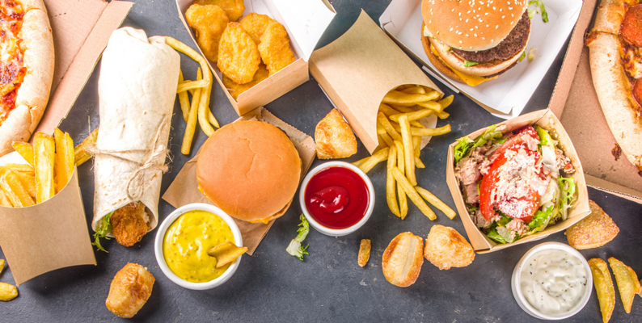
03
Introduction
This project analyzes the nutritional information of fast-food items to compare restaurants based on calories, fat, sugar, protein, sodium, fiber, and vitamins. It also identifies high-risk food items and determines which restaurant offers the healthiest overall menu using data-driven scoring.

Slide 4
04
Objectives
  Identify restaurants with the largest number of food items.
  Find the highest-calorie and highest-sugar food items.
  Compare average nutritional values across restaurants.
  Identify restaurants with high protein and lower calorie combinations.
  Develop a Health Risk Score for individual food items.
  Develop an Overall Health Score for restaurants.
  Determine which restaurant has the healthiest overall menu based on the proposed scoring system.

Slide 5
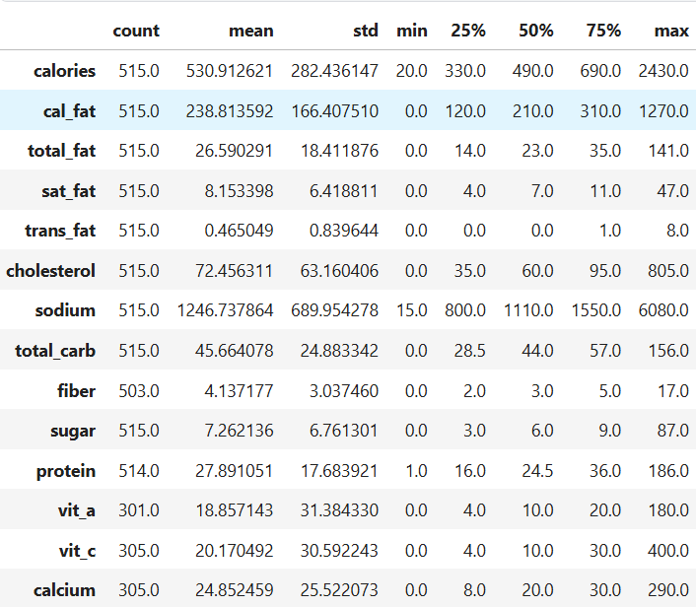
05
Dataset Overview
Dataset: Fast Food Nutrition Dataset
Records analyzed: 513 food items
Restaurants: 8
Nutritional attributes: 13
The dataset contains nutritional information including calories, fat, saturated fat, trans fat, cholesterol, sodium, carbohydrates, fiber, sugar, protein, Vitamin A, Vitamin C, and calcium.

Slide 6
06
Pseudocode
BEGIN
Load dataset
Inspect data
Remove duplicate rows
Clean categorical/text values
Convert nutrition columns to numeric
FOR each numerical column:
IF missing value exists:
Replace with median
END FOR
Validate cleaned dataset
Generate summary statistics
END
Data Preprocessing
The dataset was preprocessed to ensure clean, consistent, and reliable data for analysis. Duplicate records were removed, text values were cleaned, and nutritional attributes were converted into appropriate numeric formats. Missing numerical values were identified and replaced using median imputation. The dataset was then checked for consistency before performing further analysis.

Slide 7
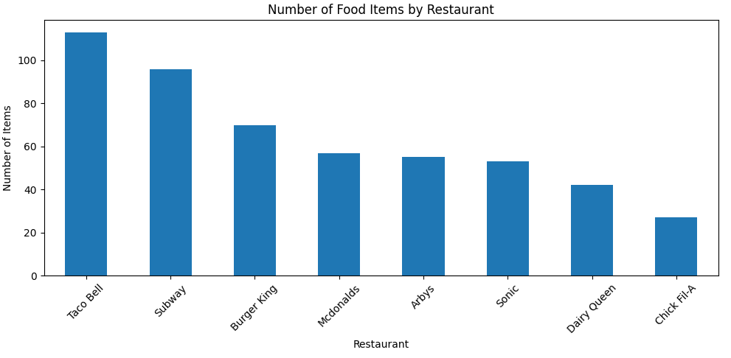
restaurant
Taco Bell 113
Subway 96
Burger King 70
Mcdonalds 57
Arbys 55
Sonic 53
Dairy Queen 42
Chick Fil-A 27
Name: item, dtype: int64
Answer: Taco Bell has the highest number of food items (113).
08
EDA-1
Restaurant-wise Food Item Distribution
Question 1: Which restaurant has the highest number of food items?
Analyze the number of food items offered by each restaurant and identify the restaurant with the largest menu.

Slide 8
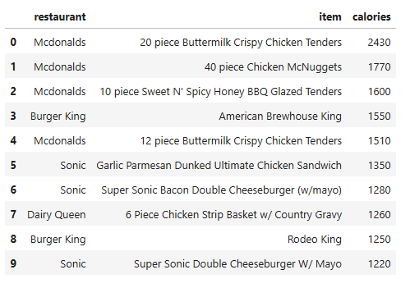
08
EDA-2
Calorie Analysis
Question 2: Which food items have the highest number of calories?
Finds the top 10 food items with the highest calorie content.

Slide 9
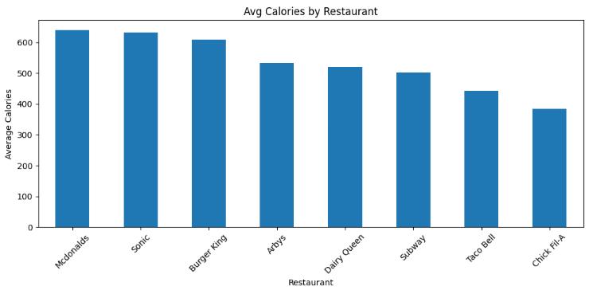
restaurant
Mcdonalds 640.35
Sonic 631.70
Burger King 608.57
Arbys 532.73
Dairy Queen 520.24
Subway 503.02
Taco Bell 443.01
Chick Fil-A 384.44
Name: calories, dtype: float64
08
EDA-3
Calorie Analysis
Question 3: What is the average calorie count of food items for each restaurant?
Determines and compares the average calorie count of food items across restaurants.

Slide 10
08
Q4: Identifies the restaurant whose food items have the highest average protein content.
Analysis:
restaurant
Mcdonalds 40.30
Chick Fil-A 31.70
Subway 30.31
Burger King 29.94
Arbys 29.25
Sonic 29.19
Dairy Queen 24.83
Taco Bell 17.38
Name: protein, dtype: float64
Answer: Mcdonalds has the highest average protein content (40.30 g).
Q5: Compares restaurants to determine the highest and lowest average total fat content.
Analysis:
restaurant
Sonic 37.64
Burger King 36.81
Mcdonalds 31.81
Dairy Queen 28.86
Arbys 26.98
Taco Bell 20.86
Subway 18.48
Chick Fil-A 16.15
Name: total_fat, dtype: float64
Highest average total fat: Sonic (37.64 g)
Lowest average total fat: Chick Fil-A (16.15 g)
EDA-4
Macronutrient Analysis
Question 4: Which restaurant offers food items with the highest average protein content?
Question 5: Which restaurant has the highest and lowest average total fat?

Slide 11
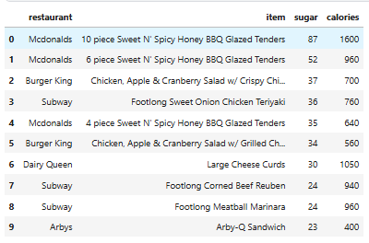
08
EDA-5
Sugar Analysis
Question 6: Which food items contain the highest amount of sugar, and how many calories do they contain?
Identifies food items with the highest sugar content and examines their corresponding calorie levels.

Slide 12
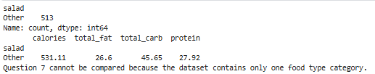
08
EDA-6
Food Type Analysis
Question 7: How does the food type (salad or other) affect average calories, fat, carbohydrates and protein?
The analysis shows that the dataset contains 0 Salad items and 513 Other food items. Since only one food category is available, a nutritional comparison between Salad and Other foods cannot be performed.
Compares salads and other food items based on average calories, fat, carbohydrates, and protein.

Slide 13
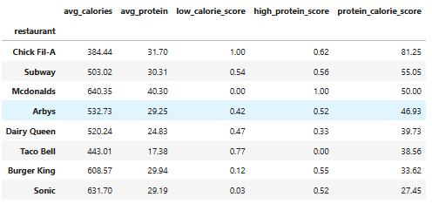
08
EDA-7
Calorie–Protein Analysis
Question 8: Which restaurant offers the best combination of low calories and high protein?
A balanced score combining low average calories (50%) and high average protein (50%) is calculated using min-max normalization.
Result: Chick Fil-A ranks first with a Protein–Calorie Score of 81.25, offering the best combination of lower calories and higher protein among the restaurants analyzed.

Slide 14
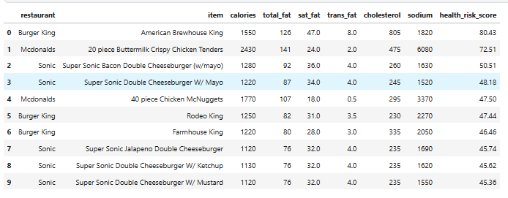
08
EDA-8
Health Risk Analysis
Question 9: Identify the 10 least healthy food items using a Health Risk Score
A Health Risk Score is calculated using six equally weighted risk factors: calories, total fat, saturated fat, trans fat, cholesterol, and sodium.
Result: Burger King’s American Brewhouse King has the highest Health Risk Score of 80.43, making it the least healthy item in the analysis.

Slide 15
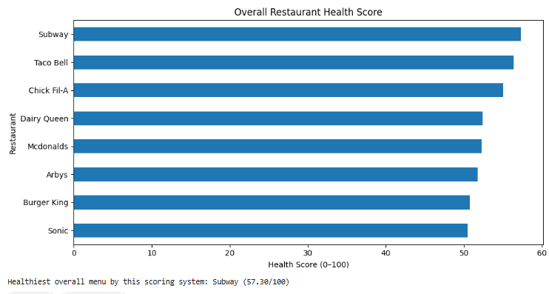
08
EDA-9
Overall Nutritional & Health Comparison
Question 10: Compare all restaurants and determine the healthiest overall menu
Restaurants are ranked using an equally weighted score based on calories, fat, sugar, sodium, fiber, protein, and vitamin/mineral content.
Subway ranks first with an Overall Health Score of 57.30, followed by Taco Bell (56.35) and Chick Fil-A (55.03).

Slide 16
12
Insights
No single restaurant dominates every nutritional category; healthier choices depend on balancing calories, protein, fats, sugar, sodium, fiber, and micronutrients.
  Chick Fil-A has the best low-calorie, high-protein balance (81.25).
  Subway ranks healthiest overall (57.30).
  Mcdonalds has the highest average protein (40.30 g) but high calories (640.35 kcal).
  Burger King’s American Brewhouse King has the highest risk score (80.43).
  High-risk foods contain more calories, fat, cholesterol, and sodium.
  Salads generally have a healthier nutritional profile.
  Healthier menus balance low calories, fat, sugar, and sodium with higher fiber and protein.

Slide 17
12
Conclusion
The analysis highlights significant nutritional differences among the restaurant menus. Each restaurant offers a mix of healthier and less healthy options, making nutritional comparison important for informed food choices.
Subway achieved the highest overall health score, while Chick Fil-A provided the best balance of low calories and high protein. High-calorie, high-fat, and high-sodium items were associated with greater health risks.
Overall, the analysis shows that healthier food choices generally involve lower calories, fat, sugar, and sodium, along with higher protein, fiber, and micronutrients.

Slide 18
12
References
[1] Checking your browser - reCAPTCHA. (n.d.). https://www.kaggle.com/datasets/ulrikthygepedersen/fastfood-nutrition
[2] pandas documentation — pandas 3.0.5 documentation. (n.d.). https://pandas.pydata.org/docs/
[3] Matplotlib documentation — Matplotlib 3.11.1 documentation. (n.d.). https://matplotlib.org/stable/index.html
[4] NumPY Documentation. (n.d.). https://numpy.org/doc/
Notebook_repo: https://www.kaggle.com/code/manish8101/fast-food-dataset-analysis

Slide 19
Thank you!

